Slide 1
Understanding Health and Wellness through Microbiome research
30th July – 1st August 2025
Dr. Tarini Shankar Ghosh
Microbiome Informatics
IIIT-Delhi
Day 1
Lecture 3

Slide 2
Workflow of analyzing amplicon-based sequences (contd.)

Slide 3
Alpha Diversity, Beta Diversity, Distance Measures

Slide 4
Alpha and Beta diversity
Alpha diversity: How diverse is a given community?
Beta diversity: How diverse are the different communities with respect to each other?

Slide 5
Alpha Diversity: Richness and Evenness
Richness: How many unique members?
Evenness: How are the members represented?

Slide 6
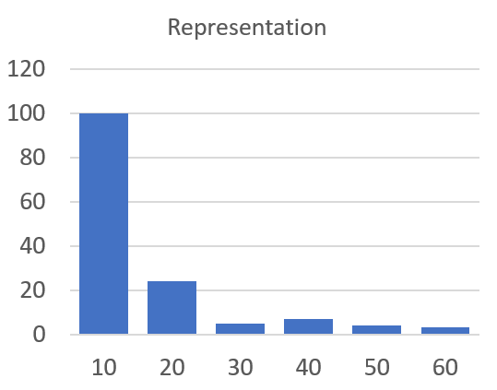
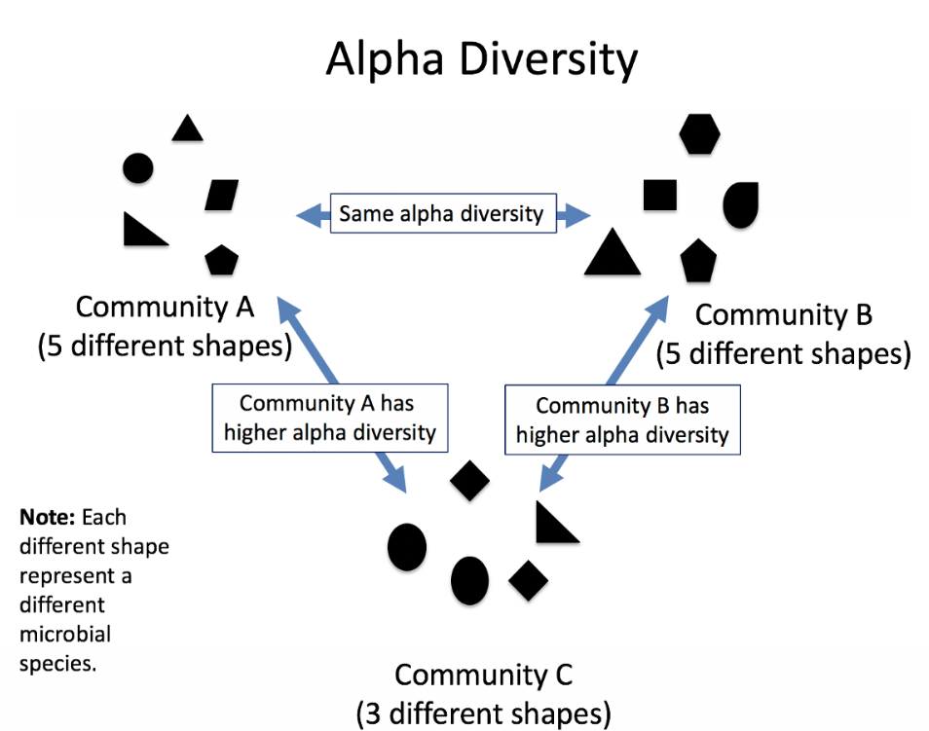
Alpha Diversity: Richness and Evenness
How diverse is a given site with respect to its own species level composition (Richness and Evenness)
Evenness: How evenly species are represented
Richness:
Number of unique species or units
Average species count
Species order (sorted)
To Measure: Shannon Index, Simpson Index, Pielou Evenness Index
https://miro.medium.com/max/1200/1*t5kdfwhco6WhHU-vNTr_yg.png

Slide 7
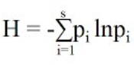
Alpha Diversity: Richness and Evenness
Shannon Index
P_{i} is the proportion of species i
Shannon Index is a representation of both richness and evenness
Pielou Evenness Index: Strictly evenness

Slide 8
More details
Alpha Diversity and Beta Diversity: https://www.youtube.com/watch?v=oWmt6NPuquQ
Extensive Tutorials on Biodiversity: https://www.youtube.com/watch?v=GZgCqIempiA&list=PL_Oc8YQQvazPGl0XJwQrGXeBhKbO7LBFP

Slide 9
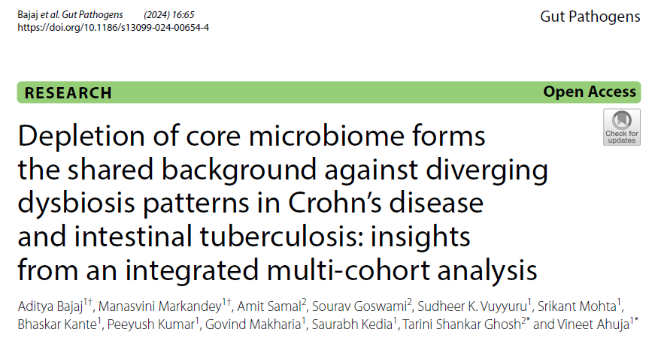
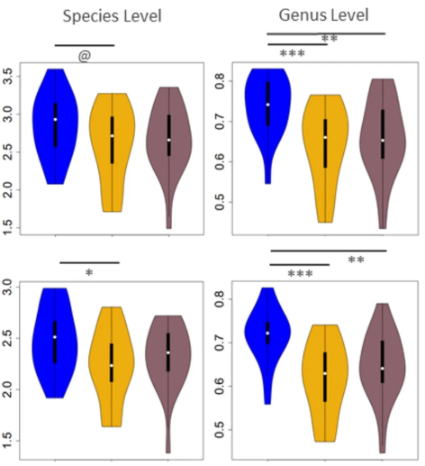
Decrease of microbial diversity with gut inflammation/infection
Shannon Index
Loss of health is significantly associated with loss of microbiome diversity irrespective of the nature of gastro-intestinal disease
Pielou’s Index
HC
CD
ITB
HC
CD
ITB
HC: Healthy Controls
CD: Crohns’ Disease
Back
ITB: Intestinal Tuberculosis

Slide 10
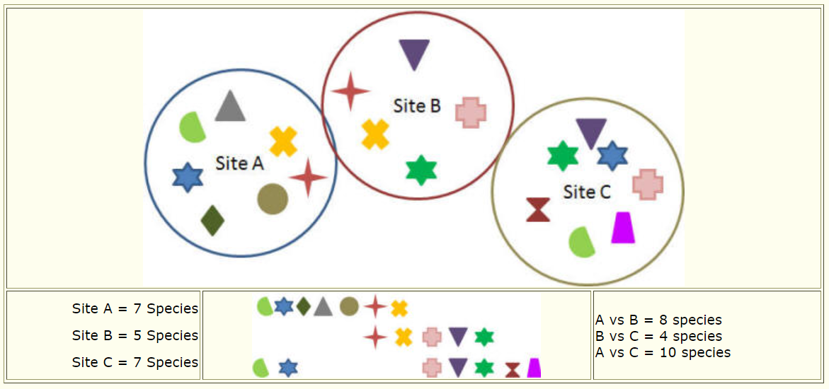
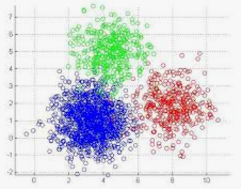
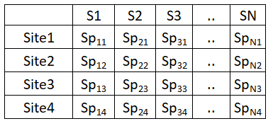
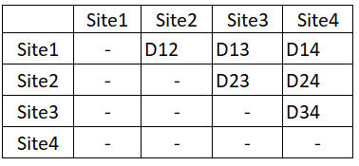
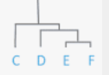
Beta Diversity
Beta Diversity: How diverse are the sites amongst each other? How do the sites vary with respect to each other?
https://www.webpages.uidaho.edu/veg_measure/modules/lessons/module%209%28composition&diversity%29/9_2_biodiversity.htm
https://miro.medium.com/max/561/0*ff7kw5DRQbs_uixR.jpg
Principal Coordinate Analysis
Distance Measures
Species Matrix
Site Distance Matrix
Tree

Slide 11
Distance Measures
There are several distance measures we can use to compute the distances between samples (or environments)
Each capture one unique aspect of microbiome variation
Abundance based: Bray-Curtis, Manhattan, Euclidean
Detection based: Jaccard
Relative ranking based (How different are the relative ranks of the different taxa within two samples): Spearman, Kendall
Phylogeny: UniFrac
Phylogeny + Abundance-based: Weighted UniFrac

Slide 12
To explore more…
Conceptual details on the different distance measures: https://docs.onecodex.com/en/articles/4150649-beta-diversity

Slide 13
Slight Diversion..
Lets learn a technique to visualize and compare value distributions

Slide 14
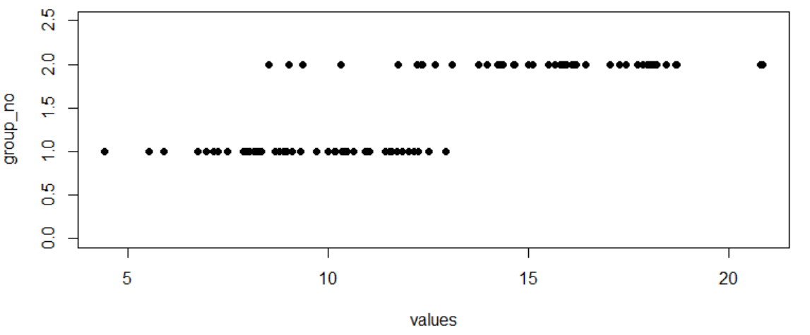
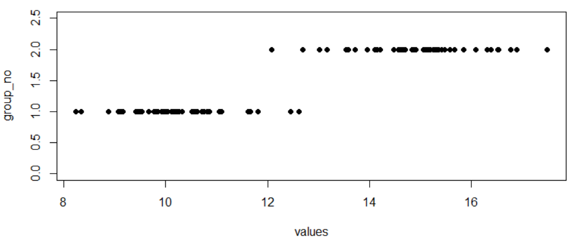
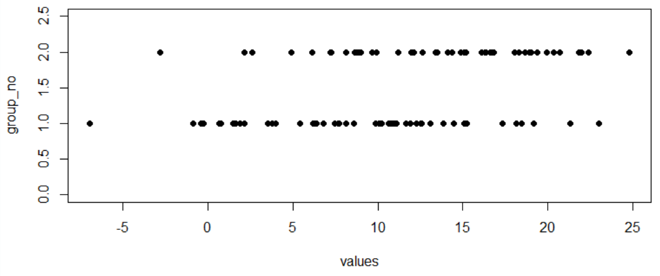
Say we are comparing values belonging to two groups
These values belonging to the same measured feature: say BMI
Comparison 1
Comparison 2
Group1
Group1
Group2
Group2
Comparison 3
Group1
In which of the comparisons, do you see the strongest separation between the two groups?
Group2

Slide 15
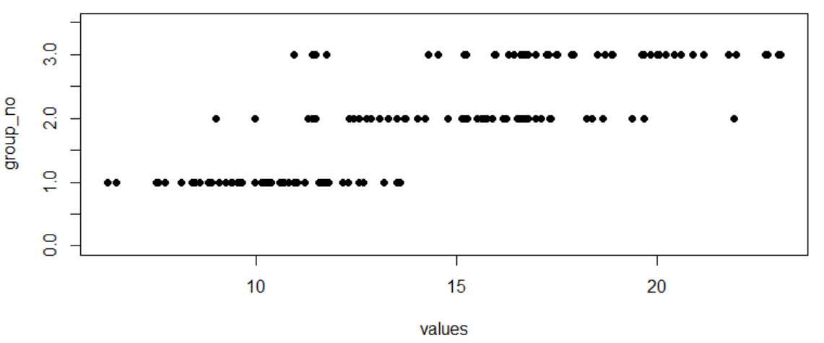
Say we are comparing values across three groups
Which two out of the three groups show the strongest differences?
Group3
Group1
Group2

Slide 16
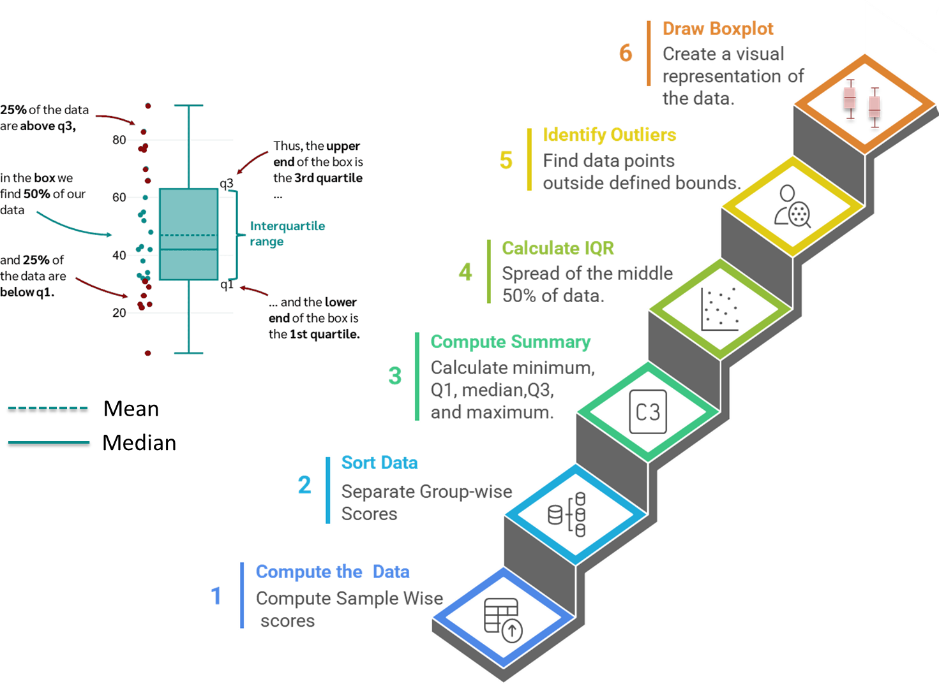
To visualize these differences in a more concise manner we use boxplots
Previous example

Slide 17
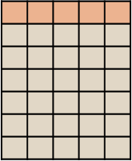
Another visualization technique
A typical microbiome sequencing project has data from multiple species. So the data is multi-dimensional
Species Abundance
.
.
How do we visualize how similar or dissimilar are these different microbiomes with respect to each other?
.
.
.
.
Microbiomes
If we just had 2 or 3 dimensions, visualizing them will be much more easier

Slide 18
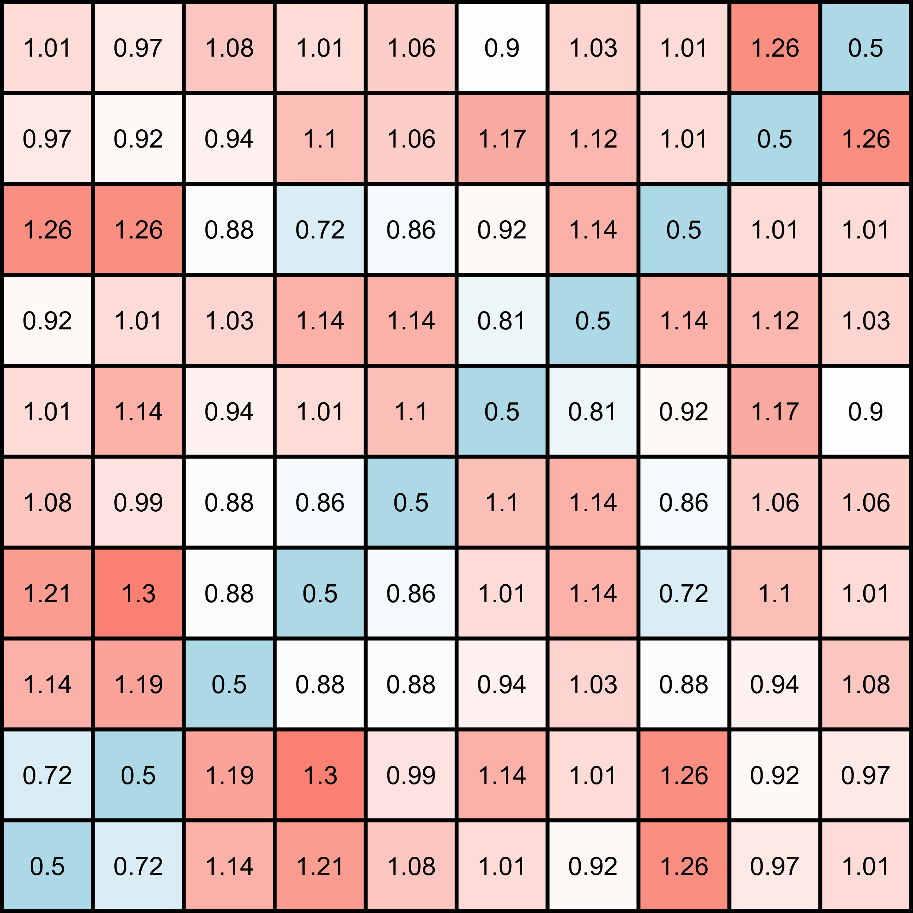
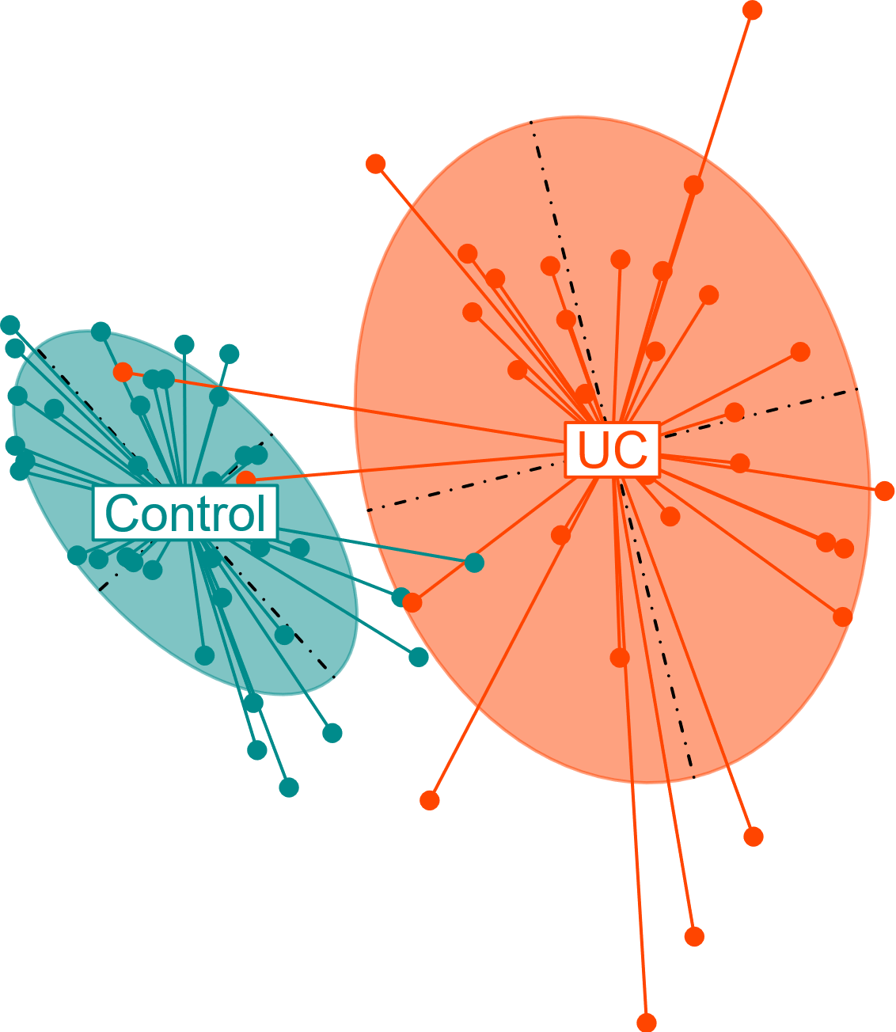
This is where techniques like Principal Coordinate/Component Analysis come in
Pairwise sample dissimilarity
based on distance metric
Visualizes sample dissimilarity
in 2D/3D space
Dissimilarity Matrix
Sample Relationships
OTU/ASV Table
Principal Coordinates
Color Data Points
Abundance of microbes in samples
Projects distance matrix into
lower dimensional space
Highlights sample groups based on metadata
Microbiomes
PC1
PC2
Label
PCoA
Algorithm
Plotting
Microbiomes
PC1
Microbiomes
PC2
PCoA
Control v/s UC
Normalized Abundance
Distance Matrix
Principal Coordinates

Slide 19
You learn more about these visualization techniques at below links
Boxplot: https://www.youtube.com/watch?v=INSIyaZUXIY&pp=ygUVQm94cGxvdCB2aXN1YWxpemF0aW9u0gcJCccJAYcqIYzv
PCA/PCoA: https://www.youtube.com/watch?v=dz8imS1vwIM

Slide 20
Now lets get back to our discussion
A combination of alpha and beta-diversity investigations of gut microbiome can reveal a lot about many diseases

Slide 21
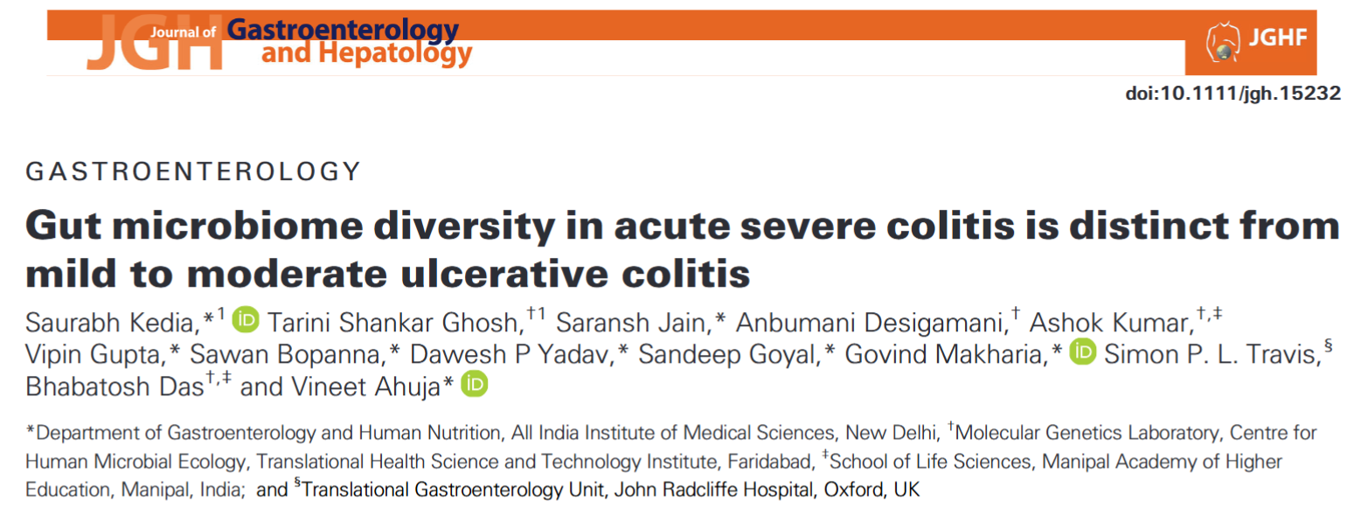
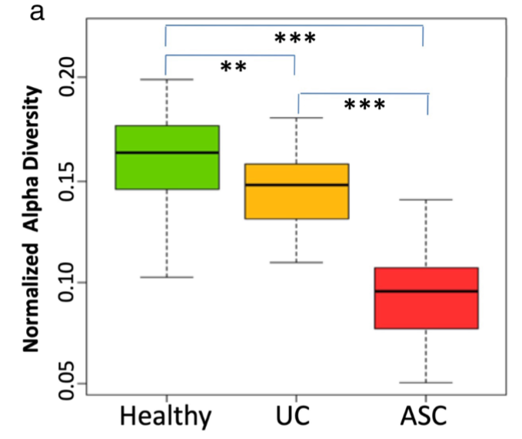
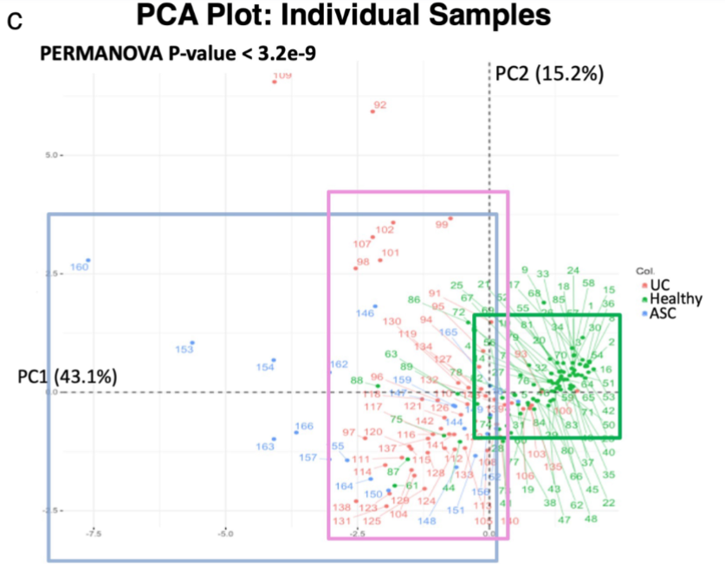
Increased microbiome variation is also an indicator of certain diseases
With disease, the diversity decreases and microbiomes become more diverse

Slide 22
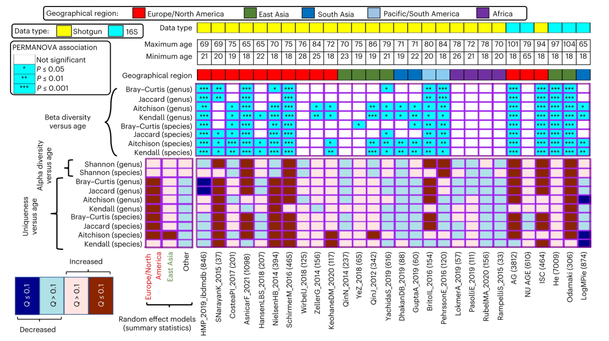
Aging-associated microbiome dysbiosis
Tarini Ghosh et al Nature Aging (to be covered in Day 3)
With increasing age, microbiomes of individuals tend to become more dissimilar to each other especially in industrialized societies

Slide 23
Rarefaction Curves
Generally, during sequencing, we may not capture the full diversity.
Improper DNA extraction
Issues during sequencing
Issues with primers
Low throughput during sequencing
Sample 1
Sample 1
Sample 3
How do we know that we have captured the full microbiome of a community? How much we may be missing?

Slide 24
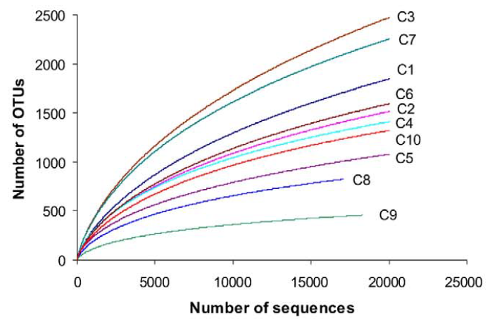
Rarefaction curves
The rarefaction curve is a plot of the number of species against the number of samples
Created by randomly re-sampling the pool of N samples several times and then plotting the average number of species found on each sample
Not Plateaued
Many additional species for more number of samples
Highly Diverse: Entire diversity not captured
Plateaued
Very few additional species for more number of samples
Less Diverse: Entire diversity captured

Slide 25
Associating microbiome features to Host-Traits: Statistical Tests

Slide 26
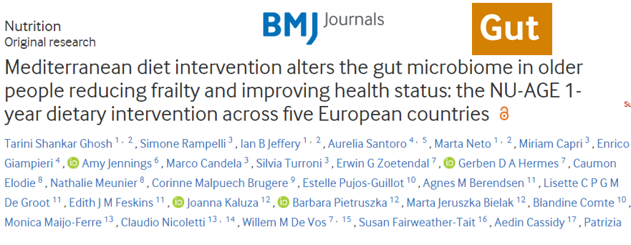


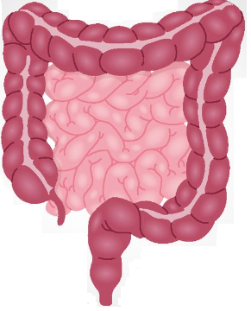
Here, we will cover some examples from this study
Gut Microbiome
Diet
Transducer
Host Health

Slide 27


Overall flow
Mediterranean Diet
Habitual Diet
..
..
..
..
Targeted 16S sequencing
Compare
Targeted 16S sequencing
Correlate with Diet, Clinical Phenotype

Slide 28
Again some basics to keep in mind

Slide 29
Say we are comparing values belonging to two groups
These values belonging to the same measured feature: say BMI
Comparison 1
Comparison 2
Group1
Group1
Group2
Group2
For all three scenarios, the mean of Group1 is 15 and mean of Group2 is 10
Comparison 3
Group1
Group2
In which of the comparisons, do you see the strongest separation between the two groups?

Slide 30
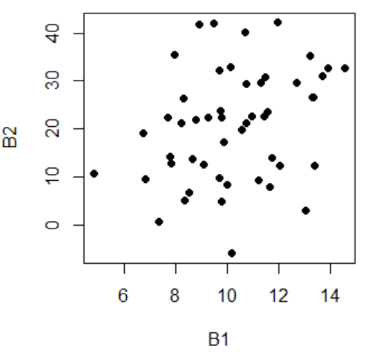
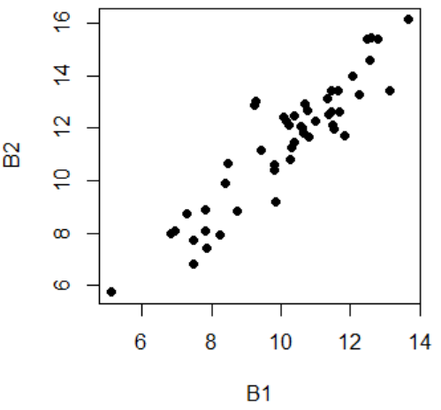
Say we are trying to identify relationships between two sets of values
Which of the scenarios has a stronger relationship?
B2 increases at 2 times the rate of B1, but there is lot of spread
B2 increases at just 1.1 times the rate of B1, but the spread is very little

Slide 31
Statistical tests/analysis
Have two components:
Effect Size: Magnitude of relationship
Significance: Inverse indicator of spread. Probability of observing this difference at random (given the spread)

Slide 32
Lets go back to our topics

Slide 33
Single Host Trait – Association with Single Microbiome Trait

Slide 34
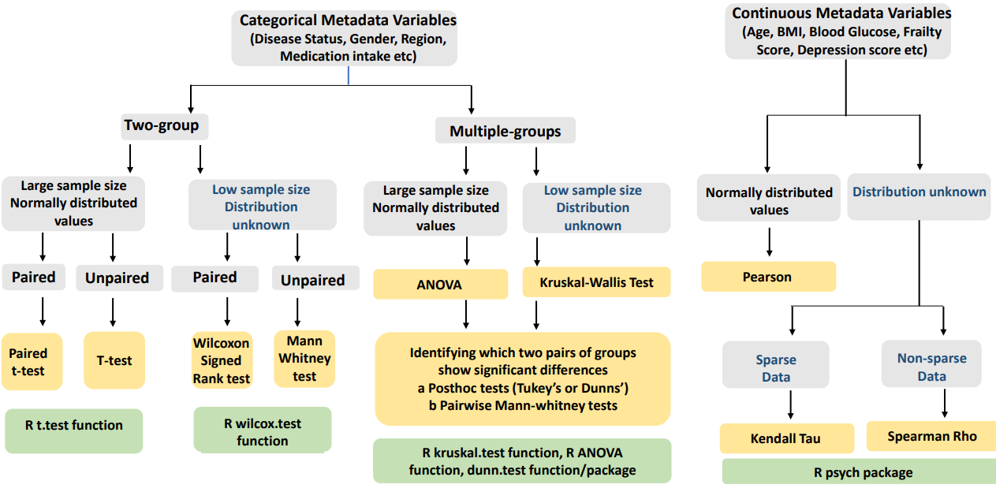
Different Methods: Single Trait – Single Taxa or Taxa-Groups

Slide 35
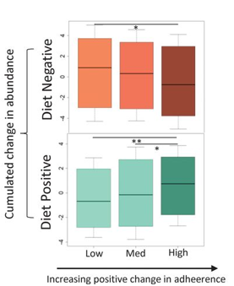
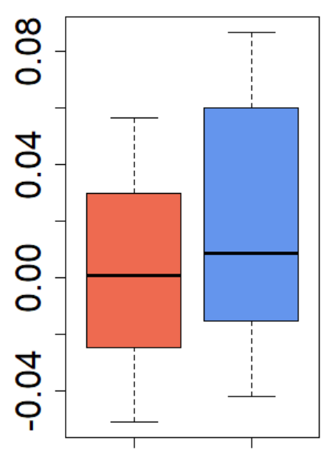
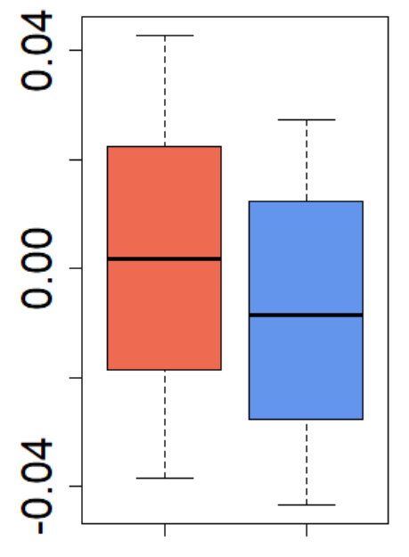
One example: Microbiome traits with single categorical host traits
Diet Positive Microbes
√
X
Diet
Adherence
X
Frailty
Mann-Whitney Test
√
Diet Negative Microbes
*: P <= 0.05
**: P <= 0.01
Abundance Change
Diet Negative
Abundance Change
Diet Positive
Individuals with reduced frailty
Individuals with increased or no change in frailty

Slide 36
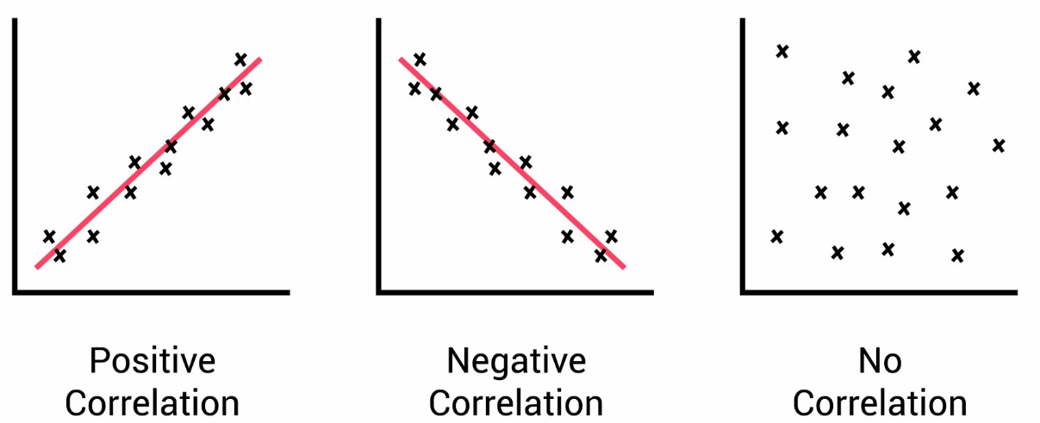
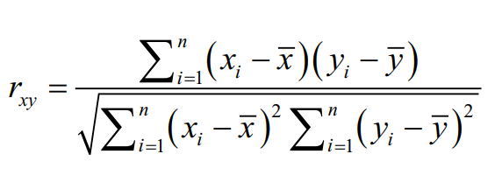
Correlation (Microbiome traits with Categorical data)
How strongly changes in diet are associated with changes in microbiome composition across individuals
Different Types
Pearson
Spearman
Same as Pearson but ranked
Kendall
For Sparse Data

Slide 37
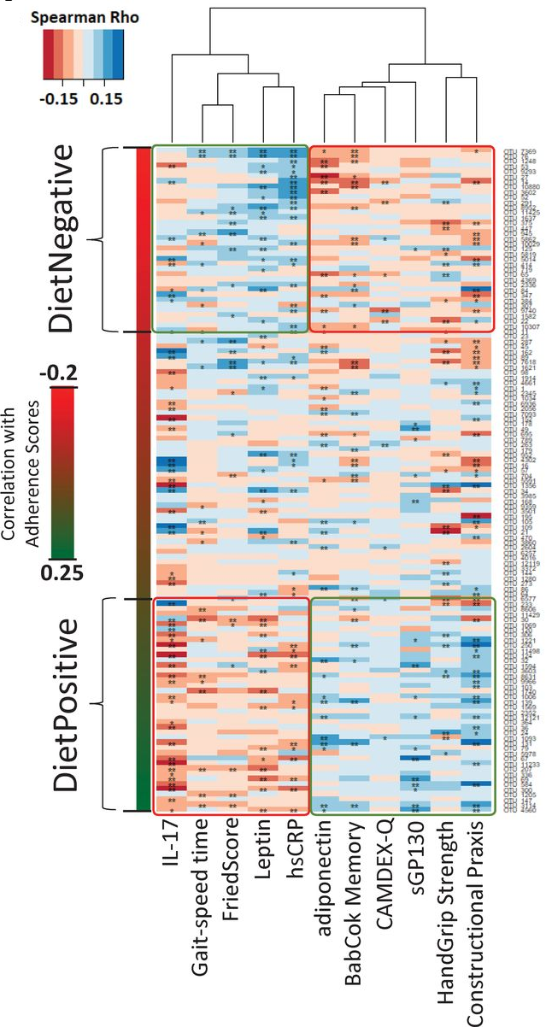
One example: Correlation analysis of Microbiome traits with continuous host traits
Diet Positive Microbes
Diet Negative Microbes
Negatively influences
Positively influences
Increased cognitive function
Reduced inflammation
Increased physical function
(Reduced Frailty)
Reduced Depression

Slide 38
PERMANOVA (Associating overall microbiome beta-diversity with single host-traits)
PERMANOVA = Permutational Multivariate Analysis of Variance
A statistical test to compare microbiome compositions across groups
Works on distance matrices (e.g., Bray-Curtis or UniFrac), not individual microbes
Commonly used to test microbiome differences by:
Disease status
Diet or lifestyle
Environmental conditions

Slide 39
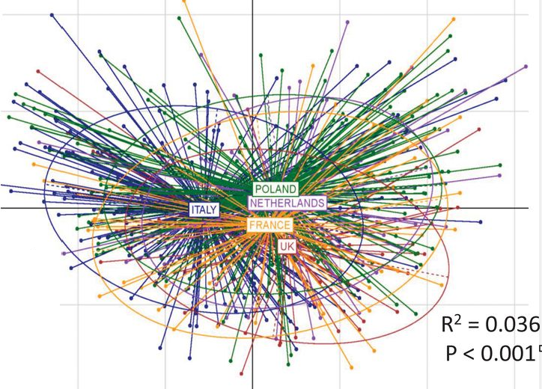
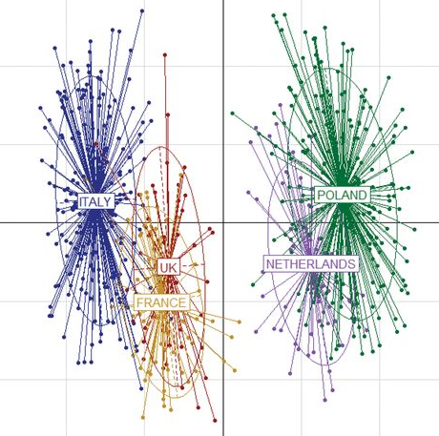
One example
Country of residence significantly influences microbiome composition
Compatriots have similar microbiome composition
Same thing for dietary consumption patterns
Next question: How do we check if dietary consumption patterns are associated with microbiome composition

Slide 40
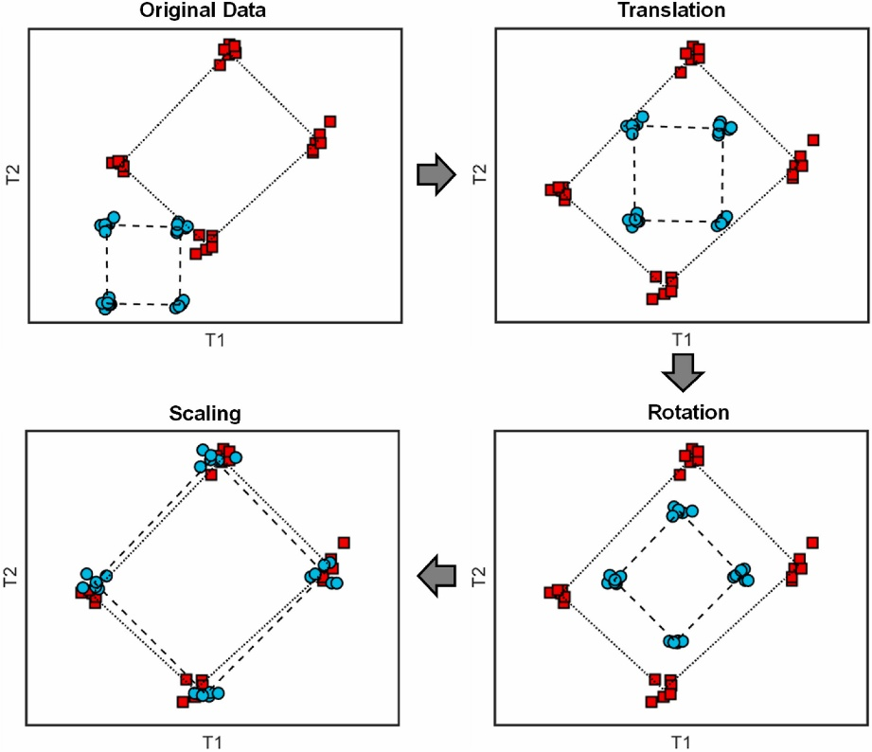
One way of answering this is using PROCUSTE
Do the patterns in microbiome composition matches between groups (groups like Disease status, Dietary style etc)?
If individuals with similar diet patterns have similar gut microbiome compositions, Procrustes analysis would show a strong alignment between the Diet and microbiome
Operations in PROCUSTE
https://www.sciencedirect.com/science/article/pii/S0169743923000916
https://www.rdocumentation.org/packages/ade4/versions/1.7-23/topics/procuste.randtest

Slide 41
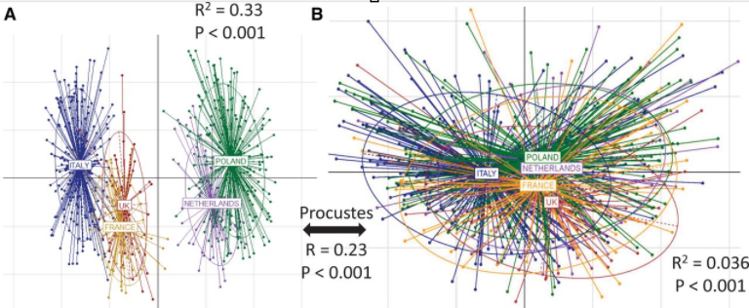
Example of the PROCUSTE analysis

Slide 42
More on PERMANOVA and PROCUSTE

Slide 43
Inferring Microbiome Function from 16S amplicon data

Slide 44
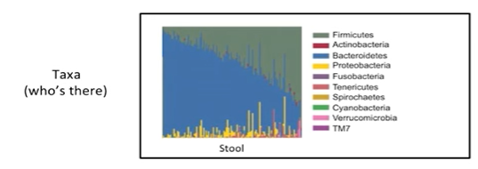
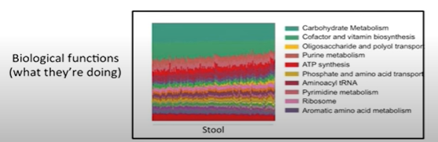
Inferring function from marker genes data
Two linked questions in a metagenomic analysis

Slide 45
Whole genome sequencing approach
Taxa Abundance
Profile
Taxonomic Reference Databases
Taxonomic Classification Programs
Metagenomic Data Set
Functional Reference Databases
Functional Profiling Programs
Functional Abundance
Profile
Taxa: Species, Genus, Family, etc
Function: Gene Families, Pathways, Modules, etc

Slide 46
Limitations
Costly
Inefficient in low microbiome biomass environments due to host contamination
Inefficient recovery of rarer species

Slide 47
Marker gene approach
Cost Effective
Efficient in low microbial biomass samples
Can identify rarer species much more efficiently

Slide 48
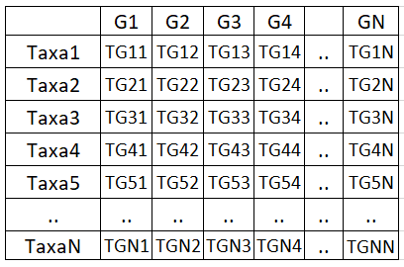
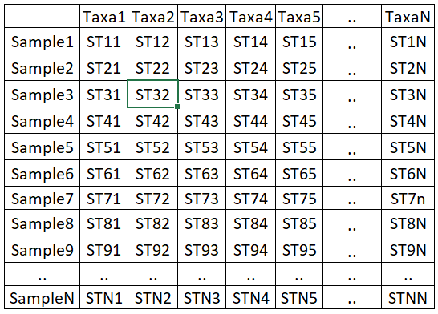
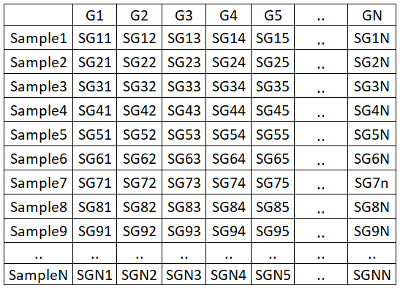
Thus an alternative…Inferred function from 16S amplicon data
We know species or taxa are there in a given environment
If we know which genes are encoded by which species … (HOW???)
We can predict which gene families (and consequently which functions) are most likely to be encoded by the given microbiome (or sample)
Taxa Abundance
Based on Marker Genes
Using Reference Databases
Functional Profiles for each sample (Inferred)
Taxa to Function Association Mapping
Samples
We know the association of each taxa with the different functions
We know what taxa are in what abundance in each sample
We infer the abundance of each function in each sample

Slide 49
Many available methods
Several example methods in this category
Each method utilizes a variant of the above approach
PICRUSt
Phylogenetic Investigation of Communities by Reconstruction of Unobserved States
https://www.nature.com/articles/nbt.2676
Tax4Fun
https://academic.oup.com/bioinformatics/article/31/17/2882/183768
Piphilin
https://journals.plos.org/plosone/article?id=10.1371/journal.pone.0166104
Vikodak
https://journals.plos.org/plosone/article?id=10.1371/journal.pone.0148347

Slide 50
Available methods (contd)
MelonnPan
https://www.nature.com/articles/s41467-019-10927-1
IPCO
https://bmcbioinformatics.biomedcentral.com/articles/10.1186/s12859-020-3404-2
Using Experimentally-Validated Metabolite-Species associations
(Ghosh et al 2020)

Slide 51
Ghosh et al 2020
Using previous literature searches
Experimentally validated metabolic production and consumption patterns of 992 species
Metabolic Functions for microbiome/sample (Inferred)
Taxa Abundance
Based on Marker Genes
Samples
We know the association of each taxa with the different functions
We know what taxa are in what abundance in each sample
We infer the abundance of each metabolic function in each sample

Slide 52
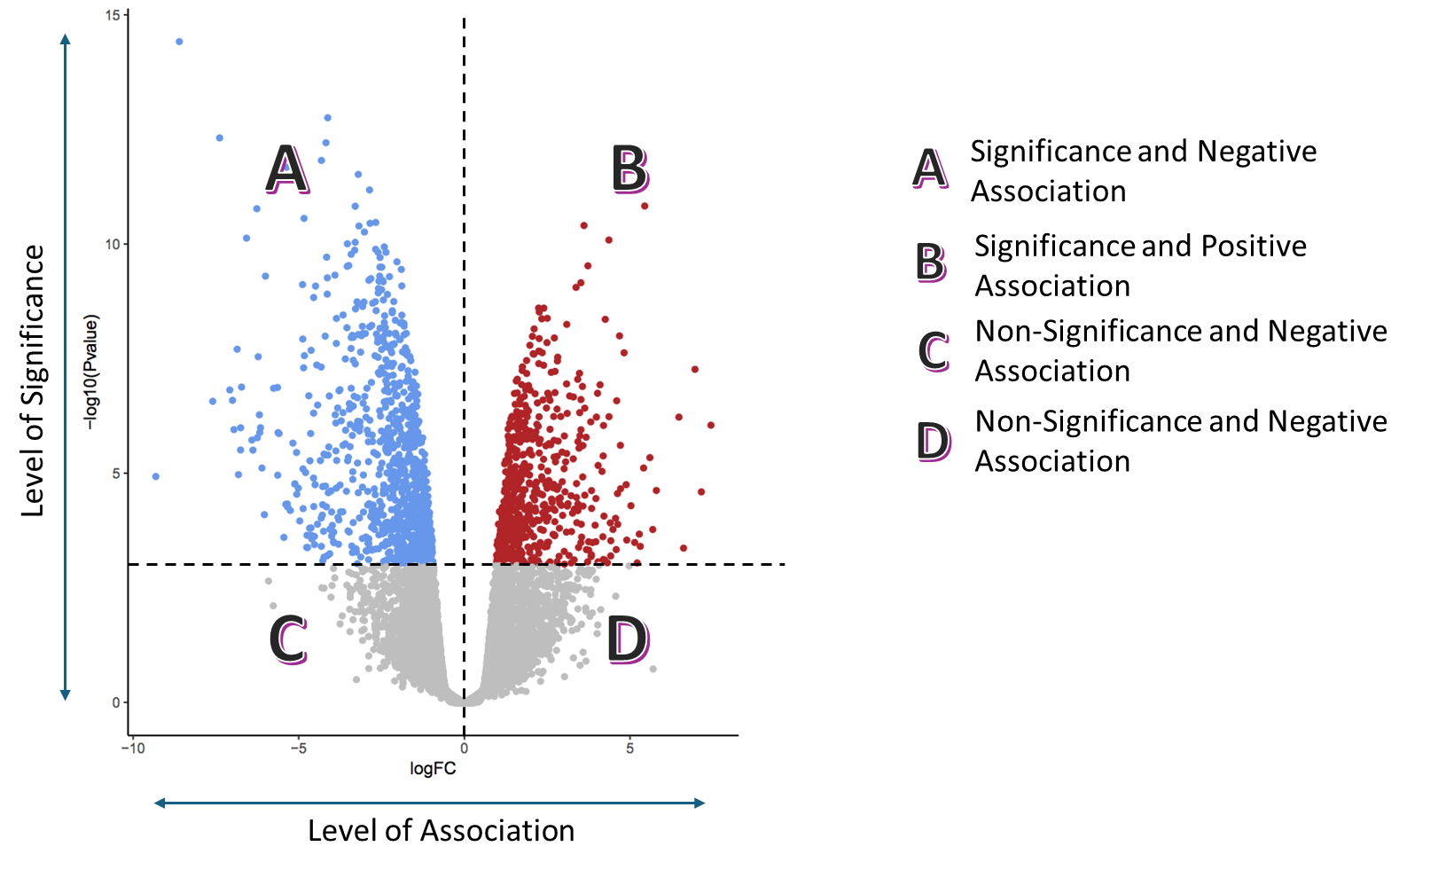
Lets look at a new visualization.. the volcano plot
https://www.youtube.com/watch?v=7aWAdw2jhj0

Slide 53
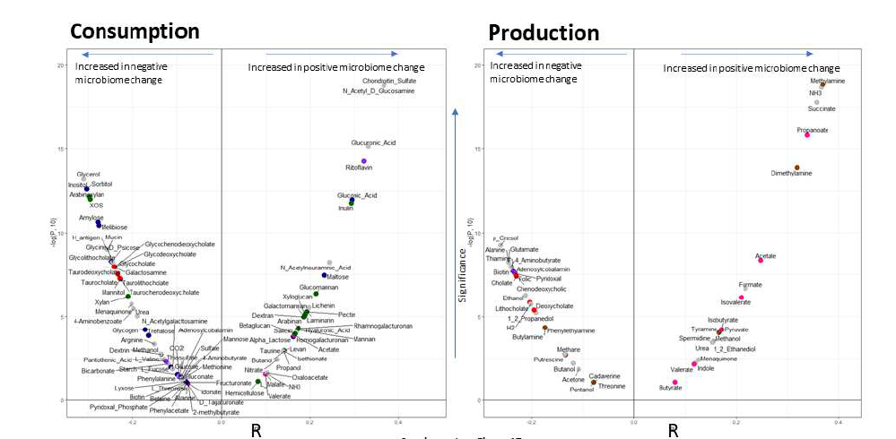
One example .. Inferred metabolic function investigations
Diet associated microbiome change is associated with increase in Short Chain Fatty Acids production and decrease in TMA and hydrophobic bile acid production

Slide 54
More details on this study in the last session for today

